Slide 1
Online Bidding System
Team 4: Qi Zhao, Yuandong Chen, Kebo Duan,
Zhuo Zheng, Yunlong Zhao
Course: CSCI 6221 Advanced Software Paradigms
Prof. Renner

Slide 2

Our Company

Slide 3
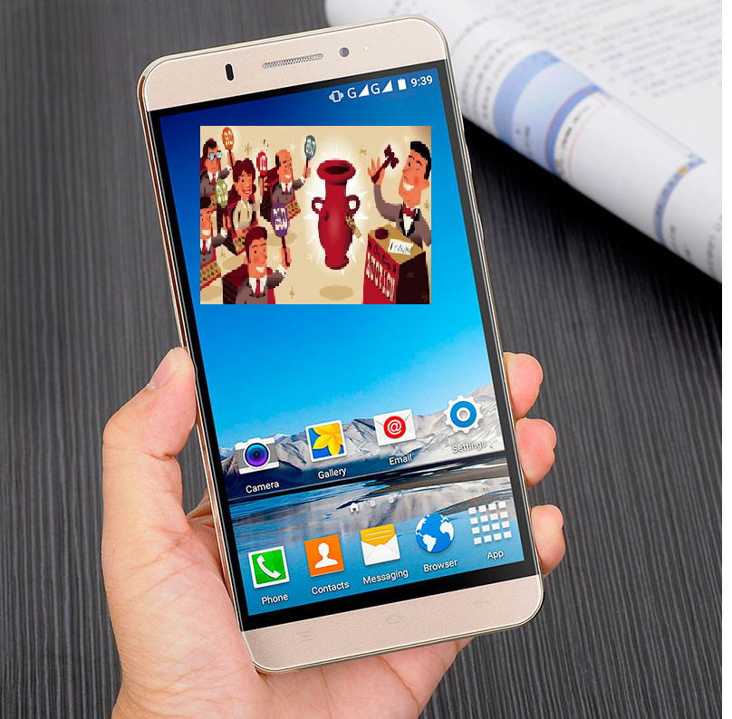











What we want
Bidding
Video

Slide 4
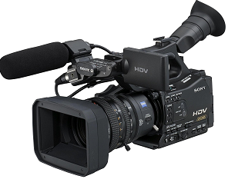
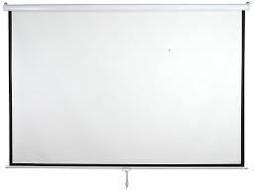

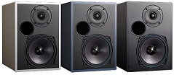








The most important requirements: similar experience (online and live)
Video system
Watch video
bid
search
Bidding
Pay the money
video
Projection system
Loudspeaker
Mr.Jack, $100!
$100 once,
$100 twice,
Done!

Slide 5





Basic structure
Video system
Screen system
Loudspeaker system
reputation system
Video system
Login/register system
Bid system
Payment system
Customer service system
Data Base
Search system
Personal information
Search
Make a payment
Customer service
Play video
Bid

Slide 6
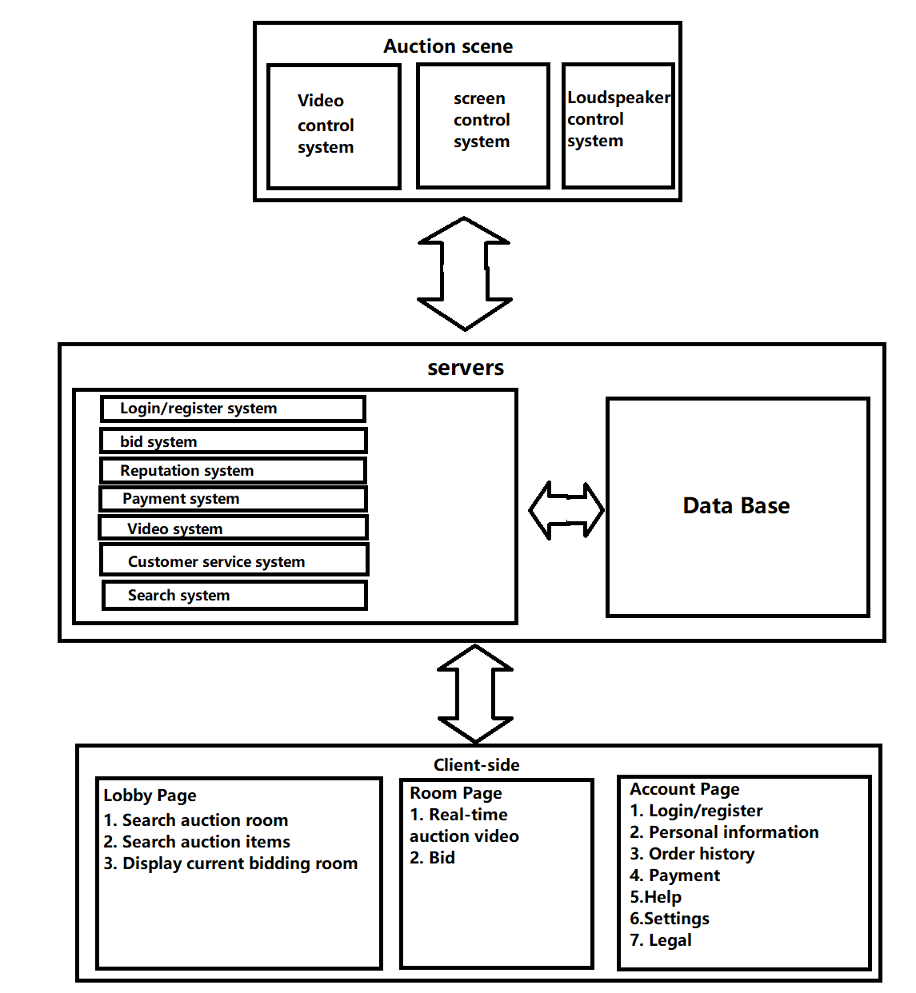
Basic structure

Slide 7
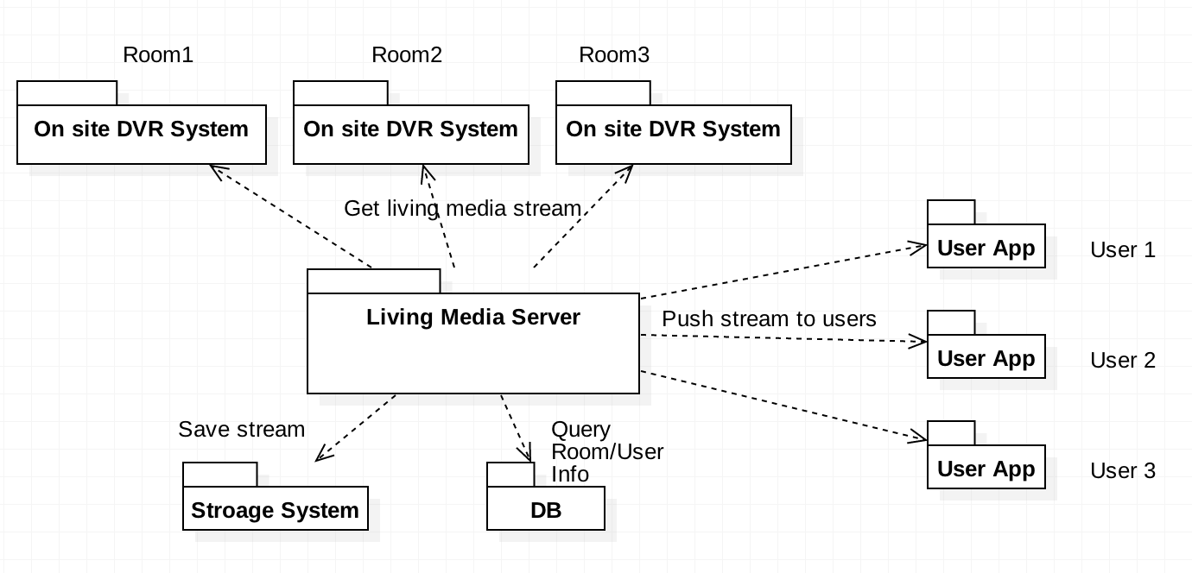
Video system
Requirements:
1. Real-time video
2. Low latency
3. First thousands of Users, maybe millions of Users in the future.
4. Reconnect
Static Architecture

Slide 8
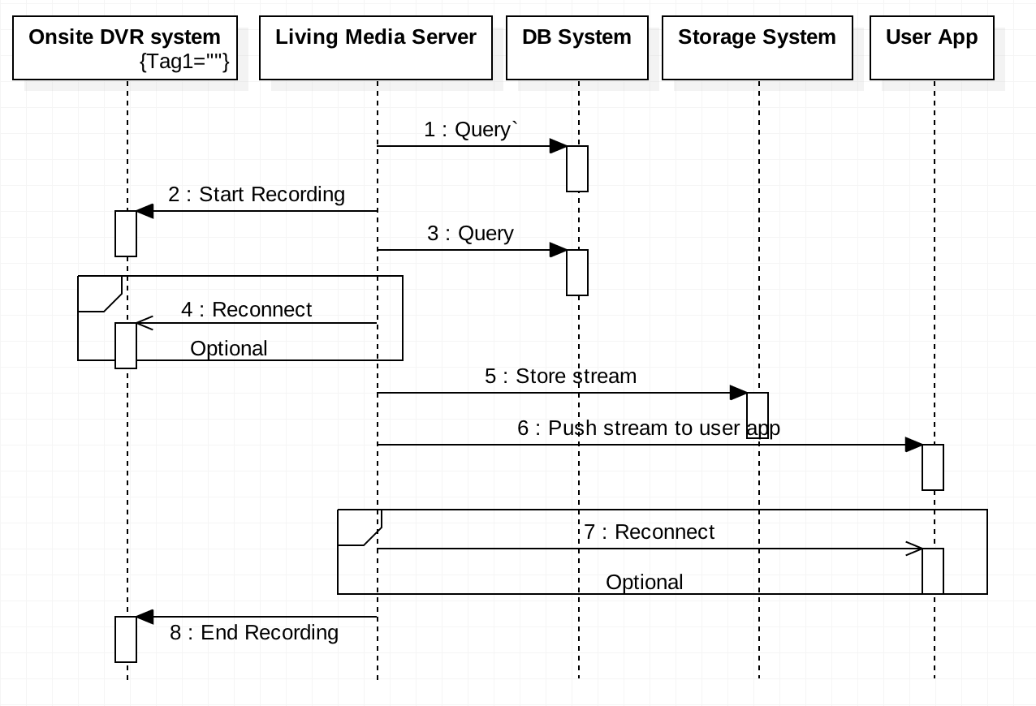
Video system

Slide 9
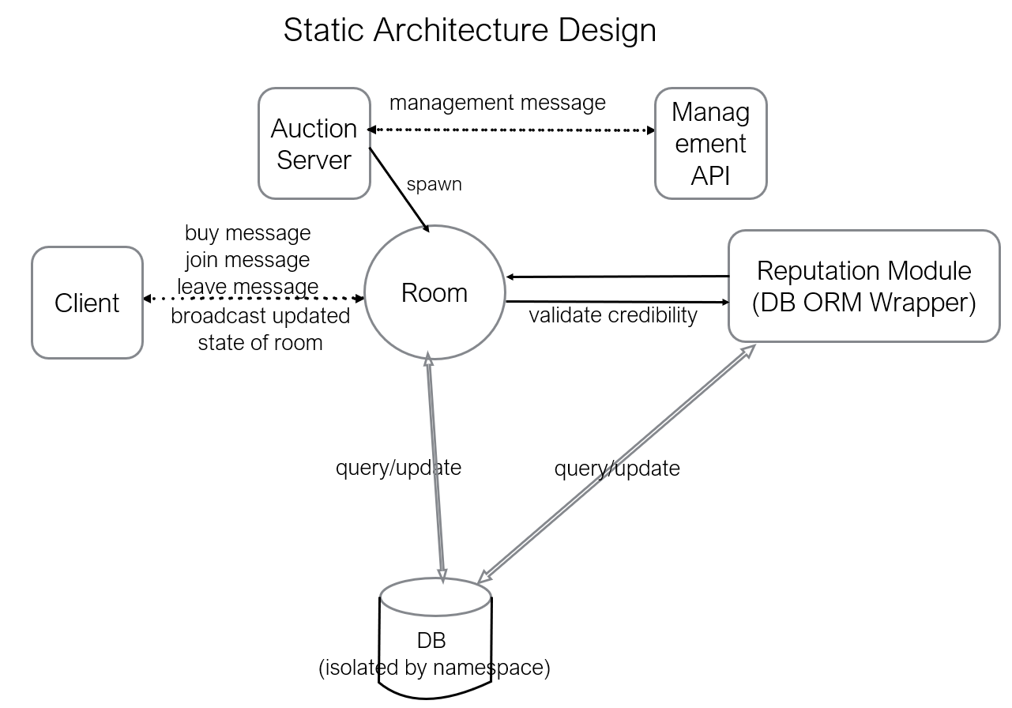
Bid(Auction) system
Requirements:
Auction must be as real-time as possible:

Slide 10
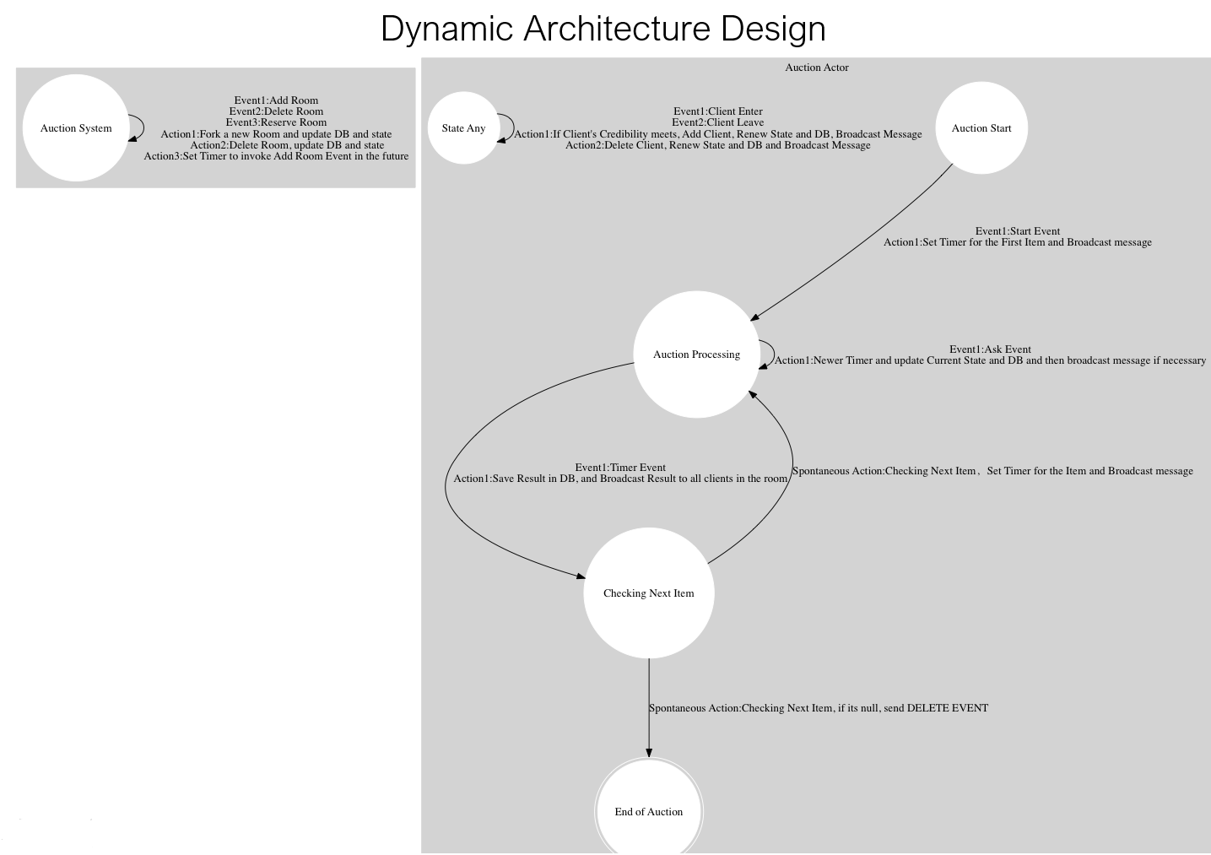
Bid(Auction) System

Slide 11
Tradeoff
Advantage
First lower cost
High data security
Higher reliability
Later lower cost
High Agility
re
?
Cloud Servers
Local servers
First higher cost
Low data security
Lower reliability
Later higher cost
Lower agility
Disanvantage

Slide 12
Thank you!

